Slide 1

Analyzing S&P 500 Stocks
Nitan Tantawichian

Slide 2
Introduction
Project Overview:
Analyze short-term performance of S&P 500 stocks
Integrate Trading View, Yahoo Finance, and Wikipedia data
Research Questions:
Identify Buy, Sell, Hold opportunities
Evaluate sector performance
Highlight stocks with highest/lowest volatility
Detect stocks with unusual trading volume
Goal:
Help investors recognize key patterns for smarter investment decisions

Slide 3
Data Dictionary
Field | Type | Description
Ticker | Text | Stock symbol used for merging and analysis
Company Name | Text | Full name of the company
Stock Price | Numeric | Latest available price from TradingView
Price % Change | Text | Stock price percentage change (with +/- and % sign)
Price % Change (Numeric) | Numeric | Cleaned stock price % change as float
Date | Date | Trading day date
30 Days Avg Volume | Numeric | 30 days average volume of each stock
Volume Spike Ratio | Numeric | Volume spike ratio of each stock, used to determined unusual volume activity
Open | Numeric | Opening price on that day
High | Numeric | Highest price on that day
Low | Numeric | Lowest price on that day
Close | Numeric | Closing price on that day
Volume | Numeric | Latest stock volume (converted to number)
Company Sector | Text | Sector classification from Wikipedia
Daily Movement | Numeric | Daily movement of each stock
Daily Volatility | Numeric | Daily volatility of each stock
Predicted Signal | Text | Classification of stock as Buy, Sell, or Hold

Slide 4
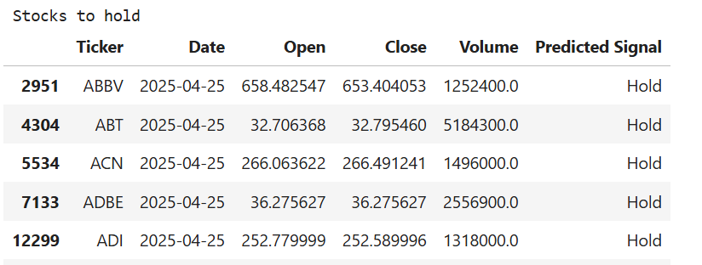
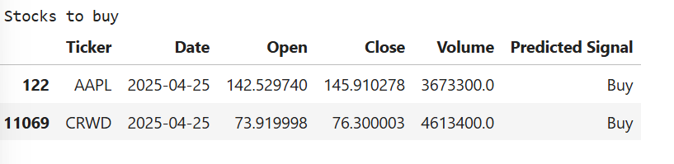
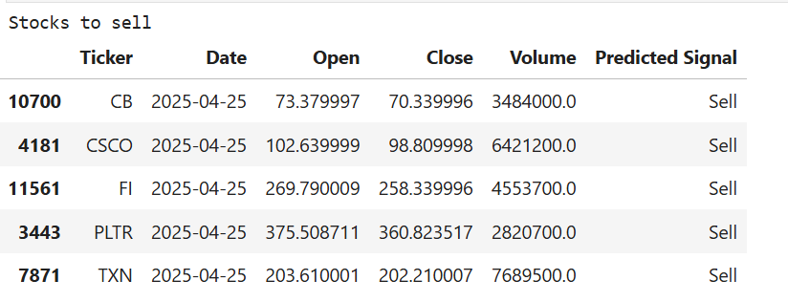
Question 1: Which stocks are good buy/sell/hold based on short-term price behavior
Used Logistic Regression to classify stocks into Buy, Sell, and Hold categories.
Simple, interpretable, and effective for multiclass classification problems.
Evaluated model performance using Confusion Matrix to observe misclassifications and F1 Score to balance precision and recall across classes.
Selected to ensure fair measurement in a multi-class, potentially imbalanced setting like stock trading signals.
Notes:
Used Logistic Regression because…
It predicts probabilities for classification tasks.
In this case, we are classifying stocks into categories like "Buy," "Hold," or "Sell," which fits a classification model.
Logistic regression is simple, interpretable, and works well when there is a clear relationship between input features (like price movement, volatility, volume) and the probability of an outcome.
F1 Score and Confusion Matrix
- The confusion matrix shows how often the model correctly or incorrectly classifies each category (e.g., how often it predicts "Buy" correctly vs. mistakenly predicting "Sell").
- The F1 score balances precision and recall, which is important because in financial decisions, both false positives (bad buys) and false negatives (missed opportunities) are costly.
- Together, they help evaluate model performance beyond just accuracy, giving a fuller picture of how reliable the predictions are.

Slide 5
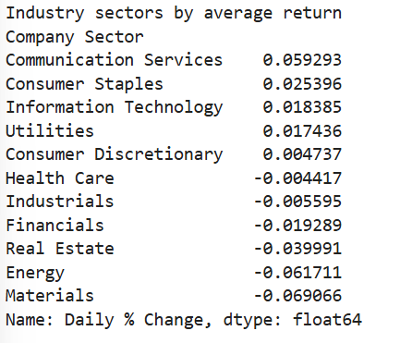
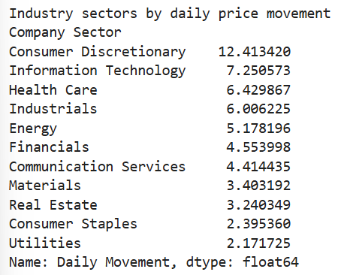
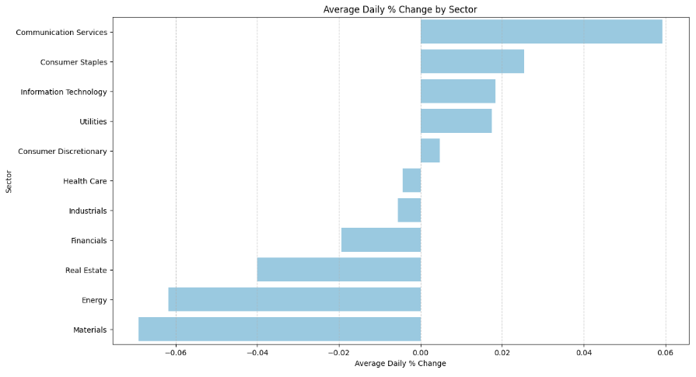
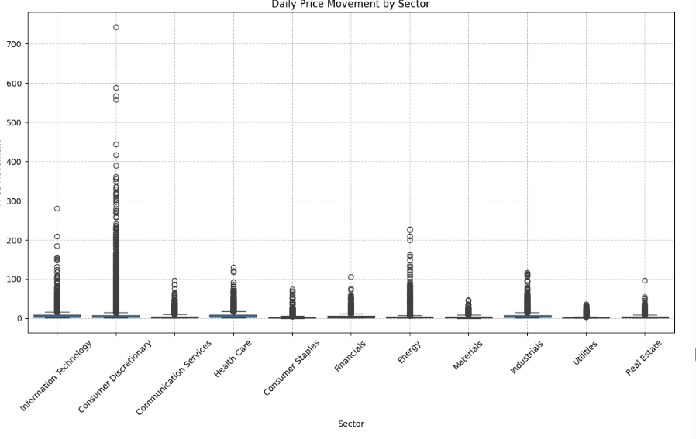
Question 2: Which industry sectors perform the best/worst in terms of avg return and price movement?

Slide 6
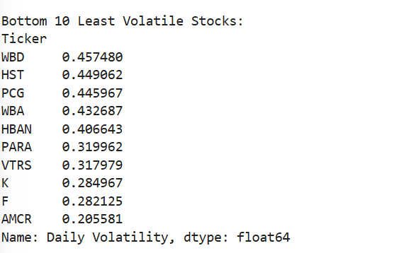
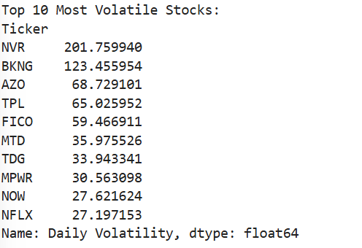
Question 3: Which stocks exhibit the highest/lowest volatility based on daily price range?

Slide 7
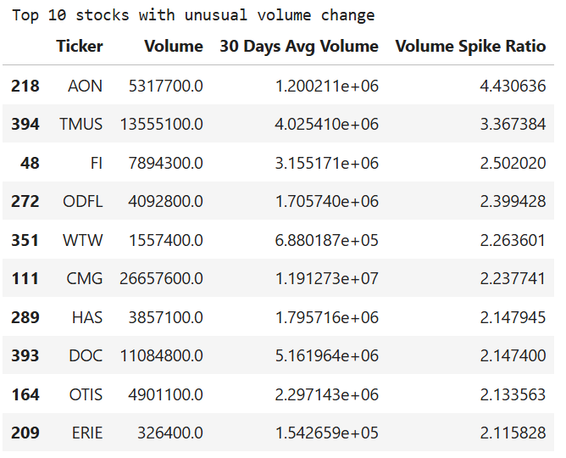
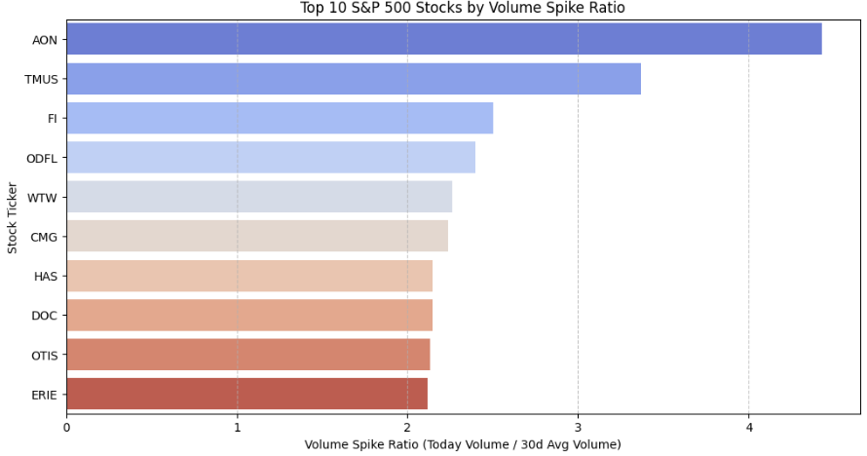
Question 4: Which stocks have unusual trading volume activity today relative to their normal average volume?
Calculated volume spike ratio to measure today’s trading activity relative to each stock’s 30-day average
Classified stocks into high volume spike group and normal volume group
Use two sample t-test to compare price % changes between the two groups
The hypothesis test evaluated whether the difference in price movement was statistically significant
A boxplot and a top 10 table were used to display the results
Notes:
A hypothesis test checks if today's trading volume is statistically different from the stock’s average volume.
The t-statistic measures how extreme today's volume is compared to the normal variation.
The p-value tells us how likely it is that such a difference happened by random chance.
If the p-value is very small (typically < 0.05), we conclude that today's volume is unusually high or low and not just normal fluctuation.
No statistically significant difference means Today's trading volume is not unusual

Slide 8
Roadmap
Finished:
Answered all the research questions
Implement machine learning, hypothesis test, and visualizations
Scraped and cleaned all the data that is needed
To Be Done:
Organized the data frame and saved into csv file
Add more graphs for better visualizations
Applied machine learning into all 503 stocks
Challenges:
Currently have two data frame, that is used to answer the questions and cannot combined them due to each data frame have its own purposed
Data is quite unorganized

